Slide 1
CONTROLLING FILE AND DIRECTORY PERMISSIONS part 1

Slide 2
users are usually collected into groups, a user must be added to a group to take the permissions of that group.
When a new user is created by default a new group is created and assigned to that user.
useradd –m alice → شو بصير لما اعمل هيك؟
New user created named alice .
New group created named alice.
Alice is assigned to that group.
We can see this by the (id) command

Slide 3
0 Reserved for the root user (superuser)
1–99 Reserved for system or special users
100–999 Reserved for system accounts (like daemon, nobody)
1000+ For regular human users (starting with the first created account)

Slide 4
We have 3 level of permissions :
1- read (r) 2- write (w) 3- execute (x)
How to grant ownership to another user?
We use the (chown) command
chown <name of the user> <file name>
e.g: chown jawad /home/jawadFile

Slide 5
groupadd <group name>
Changing ownership to a group using (chgrp)
chgrp <group to grant> <file name>
E.g chgrp security newIDS
Changing file permissions
In order to change a file permessions we use (chmod) command

Slide 6
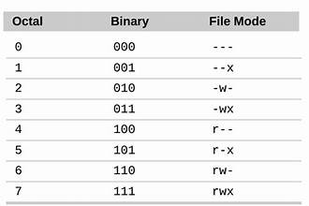

Slide 7
tasks:
What is ugo syntax for changing file permessions?
What is the umask command and how we use it?

